Slide 1

Research Methodology
Research Process
Dr. Arti Arya
Department of Computer Science and Engineering

Slide 2

Research Methodology
Research Process
Dr. Arti Arya
Department of Computer Science and Engineering

Slide 3
Research Methodology
Disclaimer
These slides are prepared from the prescribed text book and other reliable resources from the Internet.
The images are imported from various sites and videos are imported from youtube.com

Slide 4
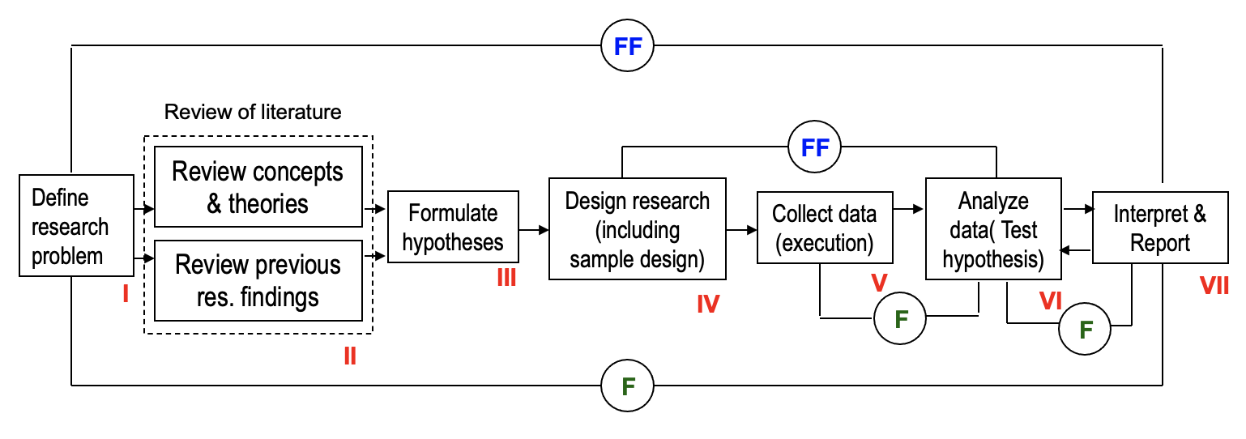

Research Methodology
Research Process
F
= feed back (Helps in controlling the sub-system to which it is transmitted
FF
= feed forward (Serves the vital function of providing criteria for evaluation

Slide 5


Research Methodology
How to choose a Research topic?
Video :https://www.youtube.com/watch?v=Q0B3Gjlu-1o

Slide 6

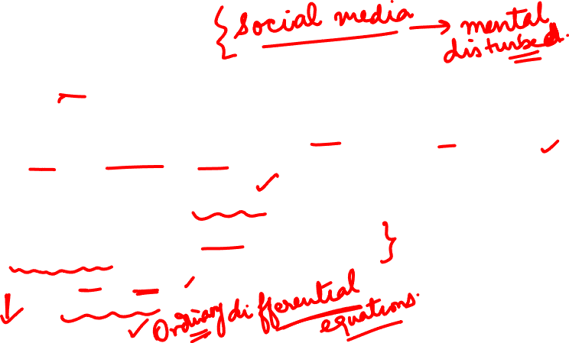
Research Methodology
Research Process
1. Formulating the Research Problem:
A problem statement is an explanation in research that describes the issue that is in need of study.
What should be there in a Problem statement?
-How will your research contribute to the existing knowledge base in your field of study?
-How is it significant?
-Why does it matter?
https://scientific-publishing.webshop.elsevier.com/research-process/what-problem-statement-examples/

Slide 7
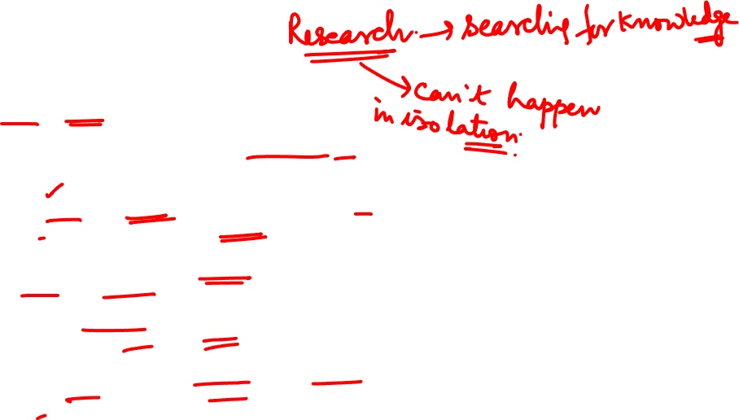
Research Methodology
Research Process
1. Formulating the Research Problem:
Think and rethink
Initially the problem may be stated in a broad general way and then the ambiguities, if any, relating to the problem be resolved.
The feasibility of a particular solution has to be considered before a working formulation of the problem can be set up.
Discuss the problem with one’s own colleagues or with those having some expertise in the matter.
Seek the help from a guide who is usually an experienced person and has several research problems in mind.
Guide puts forth the problem in general terms and it is up to the researcher to narrow it down and phrase the problem in operational terms.

Slide 8

Research Methodology
Research Process
1. Formulating the Research Problem:

Slide 9
Research Methodology
Research Process
Mehak’s organization is a few years old. As an entrepreneur, her efforts are geared toward implementing streamlined processes and procedures to make sure things keep running smoothly.
At the end of the fourth year, she decides to take stock of where they are compared to where they were. She identifies a few problems and decides to consolidate that information in a few problem statements.
“We must reduce our turnaround time by 50%, improve response time and follow through significantly to improve communication and meet our targets.”
A problem statement defines the gap between your desired goal and the current state of things. With a problem statement, organizations and individuals are able to describe what’s standing in their way, and come up with viable solutions.
https://harappa.education/harappa-diaries/examples-of-problem-statement/

Slide 10
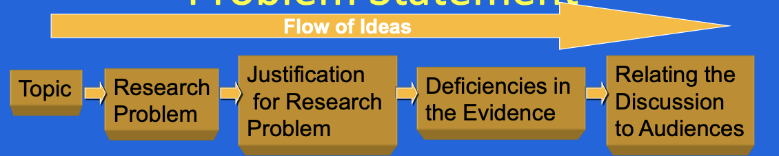
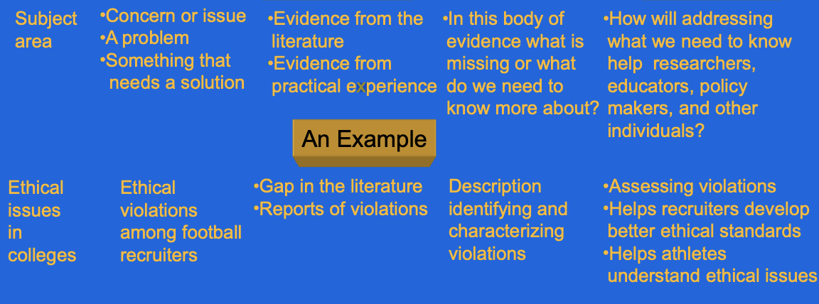
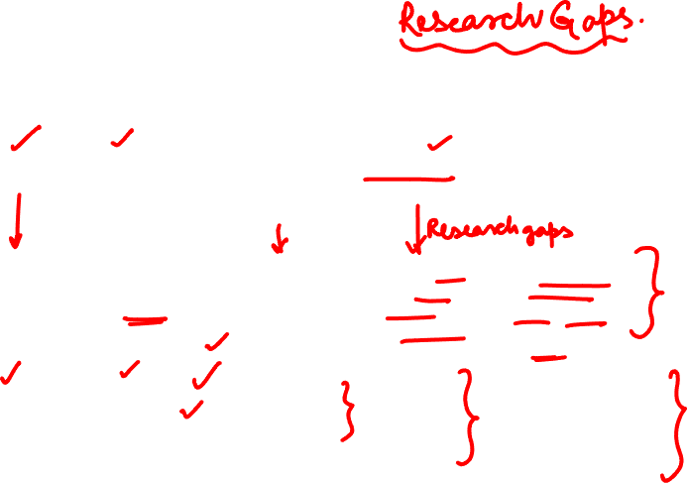
Research Methodology
Problem Statement and Research Problem
https://harappa.education/harappa-diaries/examples-of-problem-statement/

Slide 11
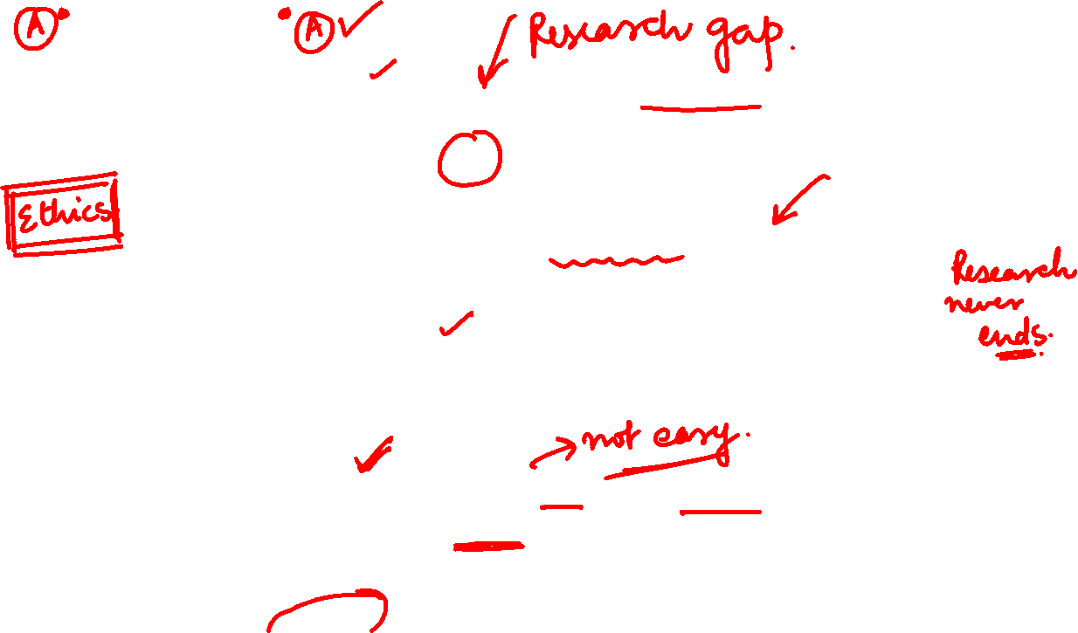
Research Methodology
Research Process: Components/Characteristics of a Research Problem
1
Must address the gap in knowledge.
2
Must contribute positively to the research.
.
3
Must help in further research directions..
4
With the data collected, the problem must be understood clearly.
5
The problem-solving approach must be ethical

Slide 12


Research Methodology
Research Process
2. Extensive Literature Survey
Academic journals, conference proceedings, government reports, books etc., must be tapped depending on the nature of the problem.
One source will lead to another.
The earlier studies, if any, which are similar to the study in hand should be carefully studied.

Slide 13

Research Methodology
Research Process
3. Development of working Hypothesis
State in clear terms the working hypothesis or hypotheses.
Working hypothesis is tentative assumption made in order to draw out and test its logical or empirical consequences.
Hypothesis should be very specific and limited to the piece of research in hand because it has to be tested.

Slide 14

Research Methodology
Research Process
3. Development of working Hypothesis
How to develop working hypotheses?
Use the following approach:
Discussion with colleagues and experts about the problem, its origin and the objectives in seeking a solution
Examine the data and records, if available, concerning the problem for possible trends, peculiarities and other clues.
Thorough Review of similar studies in the area or of the studies on similar problems
Exploratory personal investigation which involves original field interviews (IF REQUIRED)on a limited scale with interested parties and individuals with a view to secure greater insight into the practical aspects of the problem.

Slide 15

Research Methodology
Research Process
4. Research Design
Facilitates research to be as efficient as possible yielding maximal information.
Provides for the collection of relevant evidence with minimal expenditure of effort, time and money
Experimental and Non-experimental hypothesis testing.

Slide 16


Research Methodology
Research Process
4. Research Design: For preparing the research design, consider the following:
the time available for research
the cost factor relating to research
the availability and skills of the researcher and his staff (if any
How the information will be obtained and organized
the means of obtaining the information

Slide 17
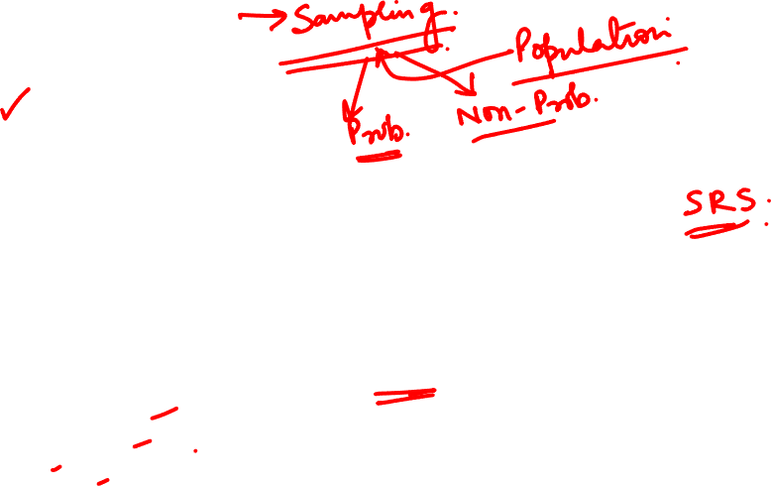
Research Methodology
Research Process
5. Determining Sample Design:
All the items under consideration in any field of inquiry constitute a ‘universe’ or ‘population’ .
A sample design is a definite plan determined before any data are actually collected for obtaining a sample from a given population.
The plan to select 12 of a city’s 200 drugstores in a certain way constitutes a sample design.
Samples can be either probability samples or non-probability samples.
Probability samples each element has a known probability of being included in the sample
Non-probability samples do not allow the researcher to determine this probability.

Slide 18
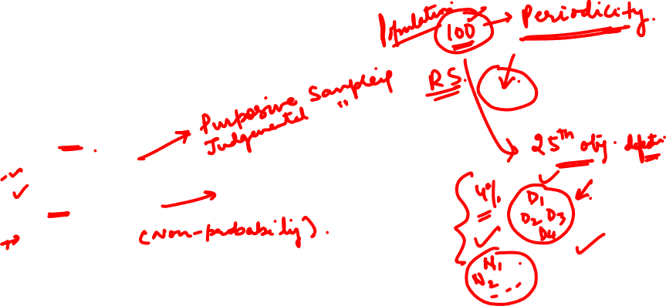
Research Methodology
Research Process
5. Determining Sample Design:
Some of the sample designs:
(i) Deliberate sampling: ( non probability sampling)
(ii) Simple random sampling:
(iii) Systematic sampling:
(iv) Stratified sampling:
(v) Quota sampling:
(vi) Cluster sampling and area sampling
(vii) Multi-stage sampling
(viii) Sequential sampling:
The sample design to be used must be decided by the researcher taking into consideration the nature of the inquiry and other related factors.

Slide 19




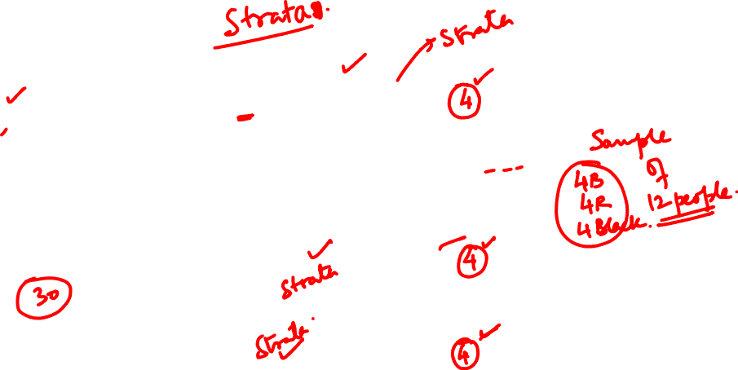

Research Methodology
Research Process
Stratified Sampling: Want a sample of 12 people
SRS
SRS

Slide 20
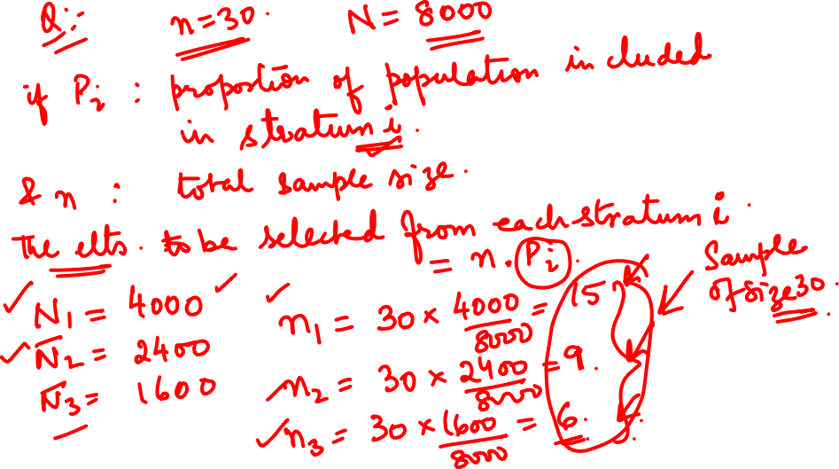

Slide 21
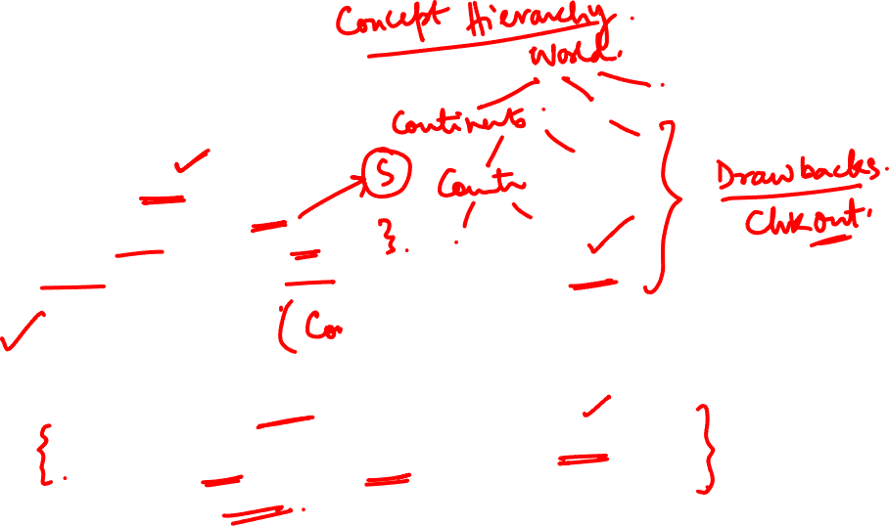
Research Methodology
Research Process
Cluster Sampling:
Suppose 15,000 customers.
We want a sample of 450.
Form 100 clusters of size 150 each.
3 clusters can be selected randomly for a sample size of 450.
Multistage Sampling:
Enhanced form of Cluster Sampling.
Meant for large geographical areas.
1st stage of sampling can be large primary units like states, then for 2nd stage districts, 3rd stage towns and so on.
Multi stage random sampling.

Slide 22

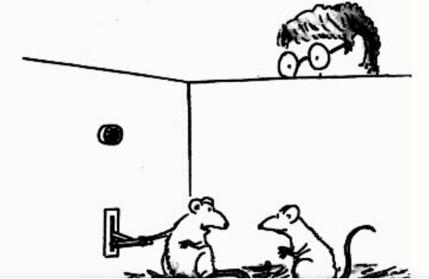




Research Methodology
Research Process
6. Collecting the Data
Data can be Primary or Secondary Data
Through personal interview:
Through telephone interviews
By observation
Through schedules:
Through questionnaires
The researcher should select one of these methods of collecting the data taking into consideration the nature of investigation, objective and scope of the inquiry, financial resources, available time and the desired degree of accuracy.

Slide 23
Research Methodology
Research Process
7. Execution of the Project:
The researcher should see that the project is executed in a systematic manner and in time.

Slide 24
Research Methodology
Research Process
8. Analysis of Data
After the data have been collected, the researcher turns to the task of analysing them.
The analysis of data requires a number of closely related operations such as establishment of categories, the application of these categories to raw data through coding, tabulation and then drawing statistical inferences.

Slide 25
Research Methodology
Research Process
9. Hypothesis Testing
After analysing the data, the researcher is in a position to test the hypotheses, if any, he had formulated earlier.
Do the facts support the hypotheses or they happen to be contrary?
Various tests, such as Chi square test, t-test, F-test, have been developed by statisticians for the purpose.
Hypothesis-testing will result in either accepting the hypothesis or rejecting it.

Slide 26
Research Methodology
Research Process
10. Generalization and Interpretation
If a hypothesis is tested and upheld several times, it may be possible for the researcher to arrive at generalisation, i.e., to build a theory.
If the researcher had no hypothesis to start with, he might seek to explain his findings on the basis of some theory. It is known as interpretation.
The process of interpretation may trigger off new questions which in turn may lead to further researches.

Slide 27
Research Methodology
Research Process
11. Preparation of the Report or the Thesis
The layout of the report should be as follows: (i) the preliminary pages; (ii) the main text, and (iii) the end matter.
The main text of the report should have the following parts:
(a) Introduction:
(b) Summary of findings:
(c) Main report:
(d) Conclusion:
At the end of the report, appendices should be enlisted in respect of all technical data. Bibliography, i.e., list of books, journals, reports, etc., consulted, should also be given in the end

Slide 28
Research Methodology
Criteria of a Good Research
The purpose of the research should be clearly defined and common concepts be used.
2. The research procedure used should be described in sufficient detail to permit another researcher to repeat the research for further advancement, keeping the continuity of what has already been attained.
3. The procedural design of the research should be carefully planned to yield results that are as objective as possible.
4. The researcher should report with complete frankness, flaws in procedural design and estimate their effects upon the findings.

Slide 29
Research Methodology
Criteria of a Good Research
5. The analysis of data should be sufficiently adequate to reveal its significance and the methods of analysis used should be appropriate. The validity and reliability of the data should be checked carefully.
6. Conclusions should be confined to those justified by the data of the research and limited to those for which the data provide an adequate basis.
7. Greater confidence in research is warranted if the researcher is experienced, has a good reputation in research and is a person of integrity.

Slide 30
Research Methodology
Problems Encountered by Researchers in India

Slide 31
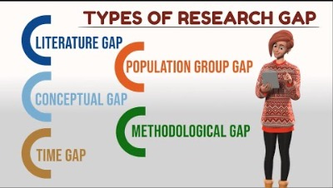
Research Methodology
Research Gap Identification

Slide 32
Research Methodology
Example of a Research Problem
STATEMENT 1
In order to provide excellent patient care at a minimal cost, Sarvodya Hospital needs diagnostic procedures that are safe, efficient, and accurate. In addition, the procedures should not be overly painful for the patient.
(Expected ideal Situation:
Diagnostic procedure –Safe, efficient, accurate and painless)
STATEMENT 2
Right now, Sarvodya Hospital's main diagnostic tools are CAT scans and myelograms (spinal taps). The CAT scan fails to make clear diagnoses 60% of the time. When the CAT scan fails, doctors must resort to the myelogram. While the myelograms are accurate, this procedure is very painful and sometimes dangerous for the patient.
(Actual Reality:
60% Failure Rate;
Myelogram –accurate but painful & Dangerous)
Content From: By Phillip Franklin https://slideplayer.com/slide/5747212/

Slide 33
Research Methodology
Example of a Research Problem
STATEMENT 3
If Sarvodya Hospital continues to do the two procedures, they will not only be wasting time and money, which jeopardizes their overall efficiency and earning potential. Also, undue suffering could lead patients to choose another hospital with more advanced facilities.
(Expected Consequences could be:
Waste of time, money, less efficient, loss, suffering)
RESEARCH
A new diagnostic technique, nuclear magnetic resonance (NMR) may surpass the CAT scan in accuracy and reduce the need to resort to the myelogram. I propose to research the feasibility of establishing an NMR lab at Sarvodya hospital. I will investigate the accuracy, efficiency, and safety of NMR as well as implementation issues.
Content From: By Phillip Franklin https://slideplayer.com/slide/5747212/

Slide 34
Research Methodology
Research Process
Example of Research Problem:

Slide 35
Research Methodology
Research Process
1. Example of Research Problem:

Slide 36
THANK YOU
Dr. Arti Arya
artiarya@pes.edu

